Slide 1
Capstone Project
E-Signing Loan based on Financial history

Slide 2
Content
Introduction
Dataset for the model
Exploratory Data Analysis
Histogram
Correlation chart with e-signed
Correlation heatmap of dataset features
Feature Engineering
Model building and Results

Slide 3
Introduction
Lending companies/ banks work by analyzing the financial history of their loan applicants and choosing whether the applicant is too risky
In order to acquire these potential applicants, companies analyze data from other marketplace.
This project targets on predicting potential customers who are getting their electronic signature (e-sign) phase passed considering the leads that intermediate marketplaces provide.
The customers who predicted to be passing e-signing can be advertised with relevant information and approached easily.

Slide 4
DATASET FOR THE MODEL
Column Name | Description
Entry_id | Unique ID provided by the marketplace
Age | Age of the applicant
Pay_schedule | The frequency of the applicant getting paid (weekly, bi-weekly, monthly, semi-monthly)
Home_owner | Whether the applicant own a house or not
Income | Income of the applicant
Years_employed | Years the applicant has been employed
Months_employed | Number of Months the applicant has been employed (represents the months which hasn’t completed a full year)
Current_address_year | Number of years spent on the current address that applicant has provided
personal_account_m | Number of months (which isn’t completing a full year) spent after creating the current bank account
personal_account_y | Number of years spent after creating the current bank account
has_debt | Whether the applicant has existing debt with financial institutes
amount_requested | Amount the user has applied as for the loan
risk_score (1-5) | Calculated risk score
ext_quality_score (1,2) | Calculated quality score
inquiries_last_month | Inquiries with the marketplace in the last month
E_signed | Whether the applicant was e-signed and able to onboard on next processes
Dataset was taken from online resource [1]
E-Signed column represents the dependent variable of the dataset

Slide 5
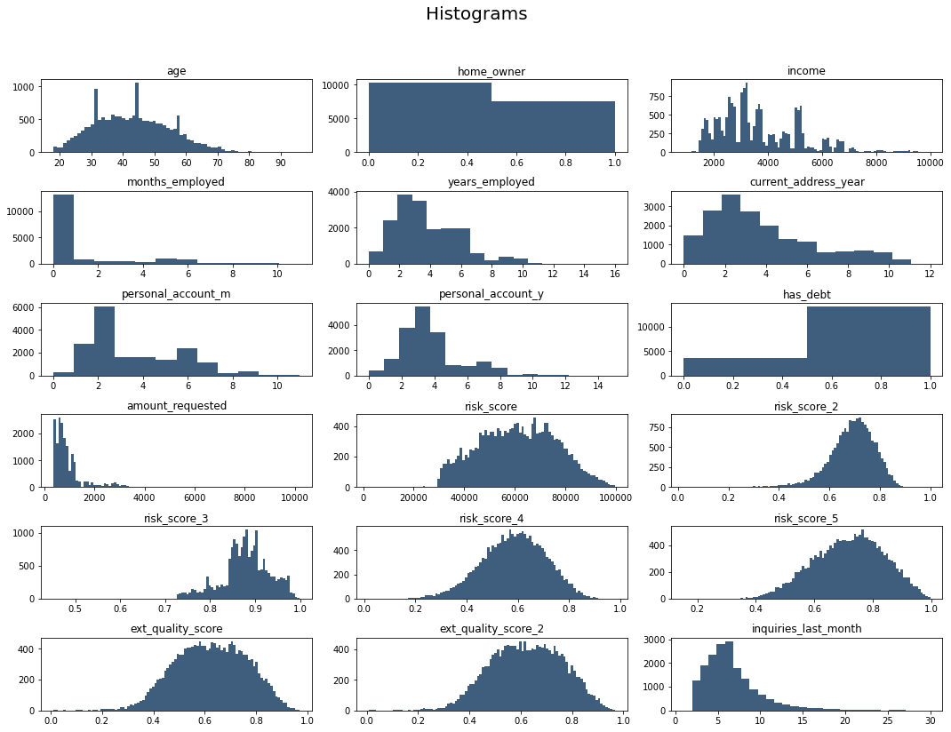
Exploratory Data Analysis
The histogram plot shows how the data has been distributed in the dataset

Slide 6
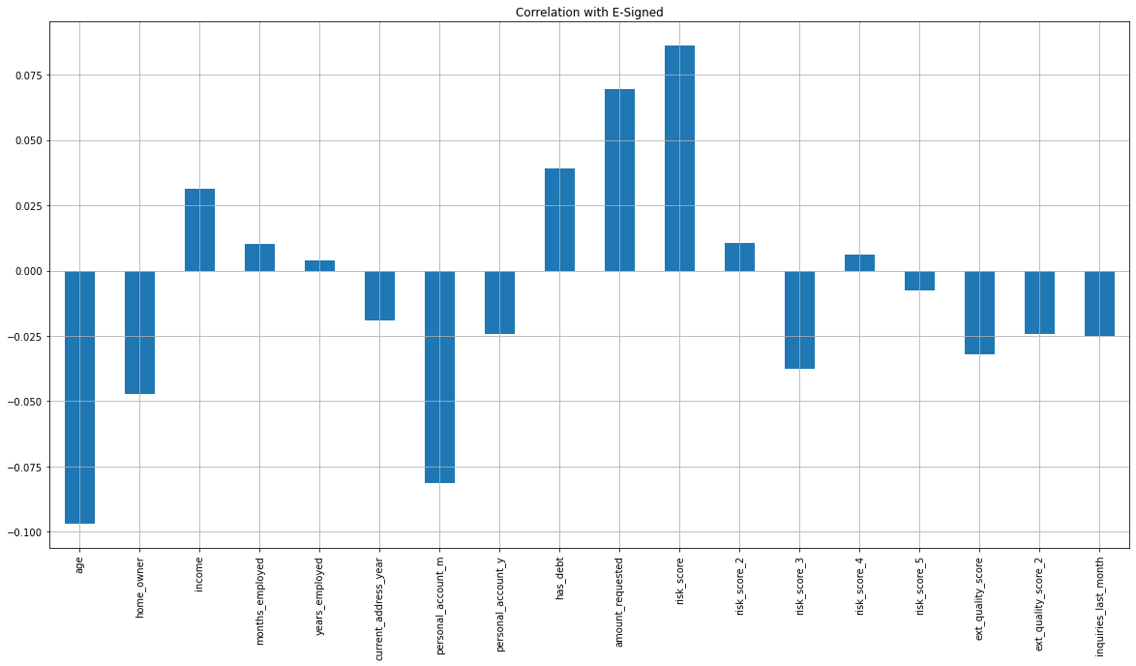
Exploratory Data Analysis
Correlation of features with the ‘e-signed’ column
Higher the magnitude of bars in the chart, more impact it has on the ‘e-signed’ feature

Slide 7
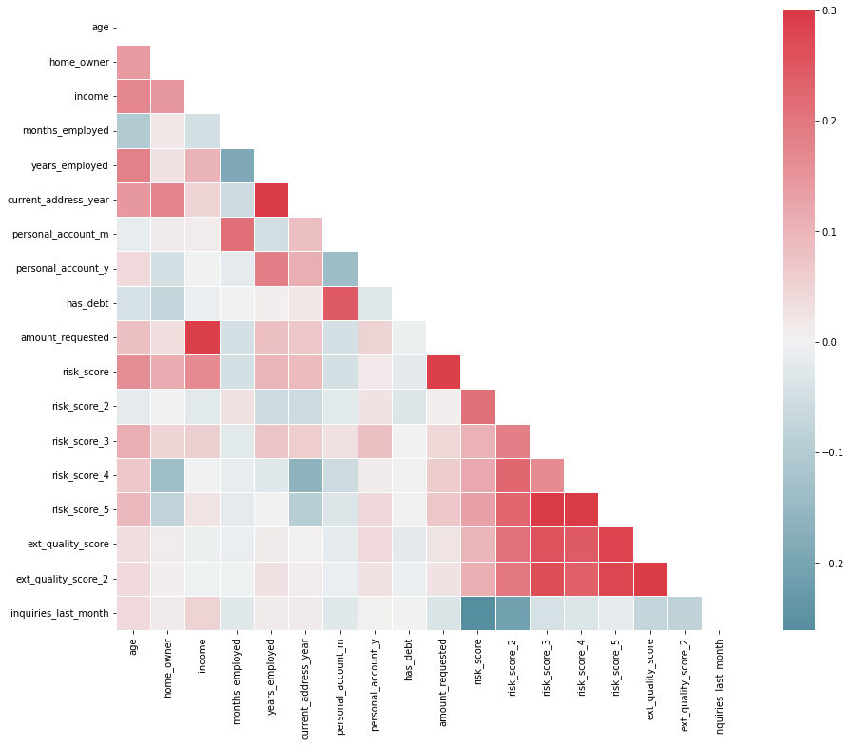
Exploratory Data Analysis
More magnitude the cells represent, the affect on both features have on each other is higher

Slide 8
Feature Engineering
Categorical variables has been one hot encoded in order to input into the classifier
Pay_schedule_monthly column has been removed from the feature engineered dataset to avoid multi-collinearity trap by dummy variables
Feature Encoded | Encoded Column Names | Records
‘Pay_schedule’ | ‘Pay_schedule_weekly’ | 3696
 | ‘Pay_schedule_bi_weekly’ | 10716
 | ‘Pay_schedule_monthly’ | 1492
 | ‘Pay_schedule_semi_monthly’ | 2004

Slide 9
Model Building & Results
Four models has been trained for the dataset in order to predict e-signing factor.
Following table represents the accuracy parameters taken after the model is trained
 | Model | Accuracy | Precision | F1 Score | ROC_auc
0 | Linear Regression (Lasso) | 0.554160 | 0.567249 | 0.538414 | 0.576123
1 | Random Forest (n=100) | 0.622836 | 0.641491 | 0.621566 | 0.682103
2 | Random Forest (bootstrap=false, entropy, max_d... | 0.634562 | 0.648870 | 0.632708 | 0.692739
3 | Random Forest (bootstrap=false, entropy, max_d... | 0.630653 | 0.644254 | 0.628465 | 0.692435

Slide 10
THANK YOU
Ranush Wickramarathne
mmoveen@gmail.com | ranushw@uom.lk
Github: github.com/ranushw

